Slide 1
Salesforce Fundamentals with Seenit
Trevor
Kleinstuber
A Forum-Based
Demographic Info
Analyst Firm

Slide 2
Software Development Life Cycle
Backlog
Design
Development
Testing
Release
Features to be added
Analyze requirements
Build and code product
Ensure quality
Deploy for use

Slide 3
Lightning Web Components
HTML
Reusable and composable components for dynamic and responsive single-page websites
Building Blocks
JavaScript
CSS

Slide 4
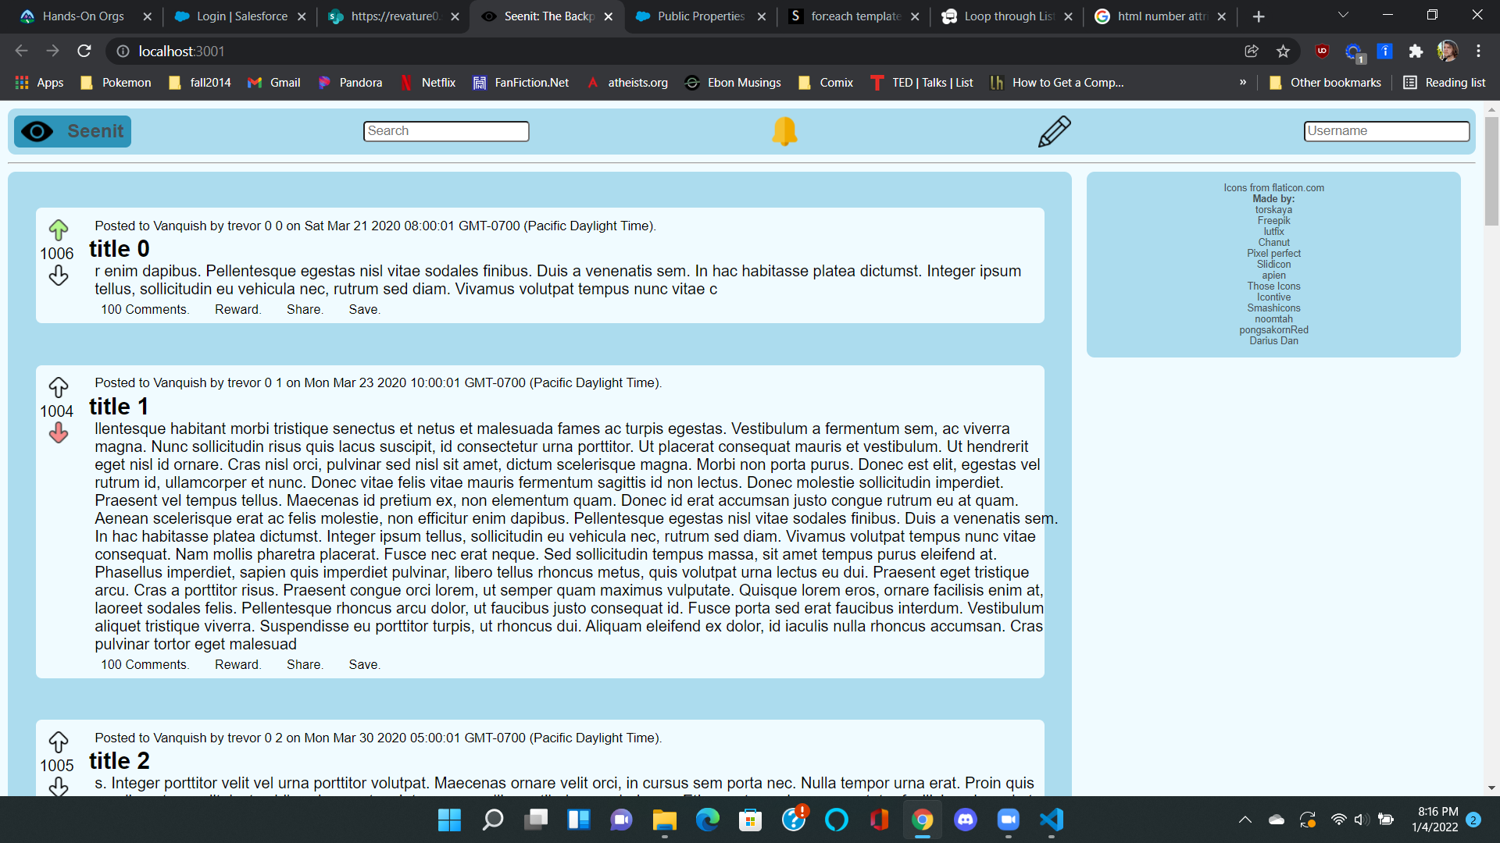

Slide 5
Cloud Data Model
Objects
Fields
The Salesforce Database Data Model
Tables
Columns
Rows
Foreign Keys
Records
Relationships

Slide 6
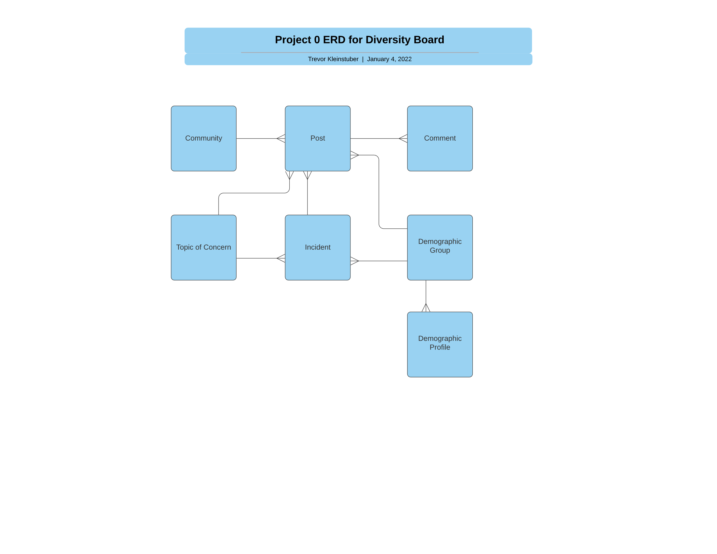
See Schema Builder

Slide 7
Information Security
Org
Defaults for the whole org
Permissions
Dynamic Expanding Access
Profile & Role
Different Types of Users/Employees
Object
CRUD Access for each Table
Record
Automatic and Manual Sharing
Field
Datum-Specific Secuirty

Slide 8
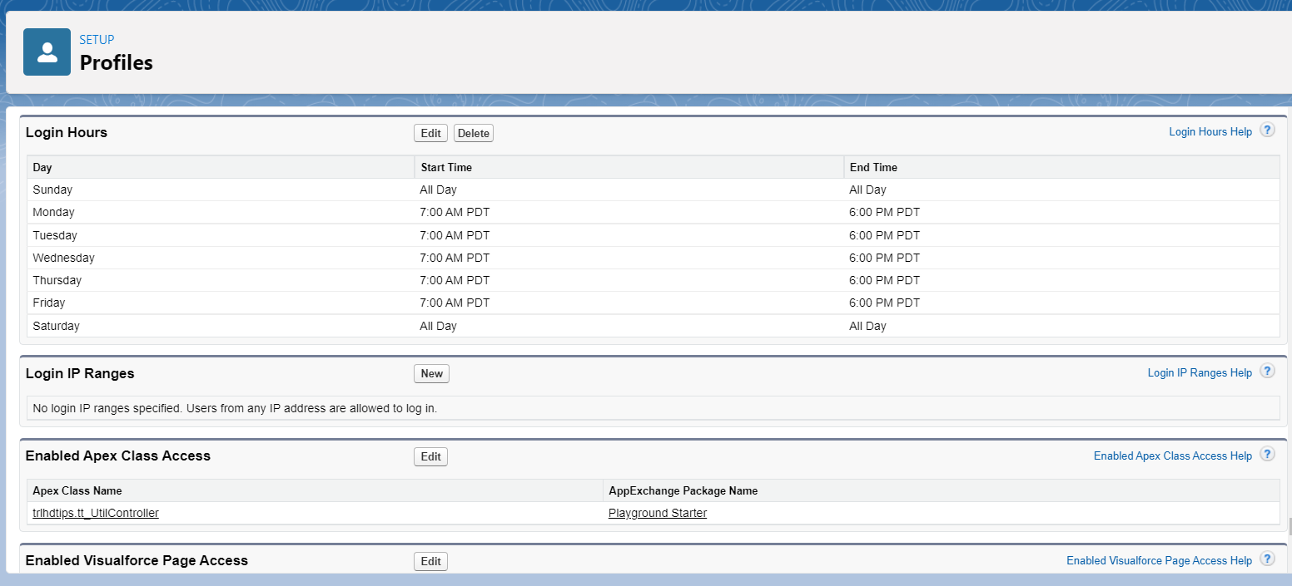

Slide 9
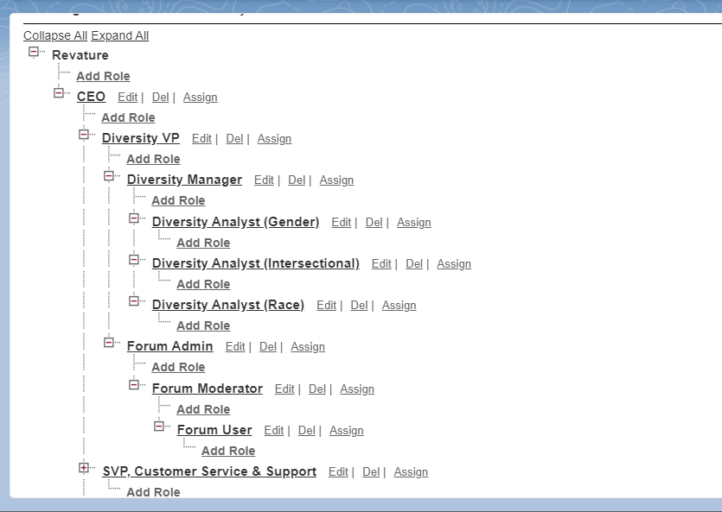

Slide 10
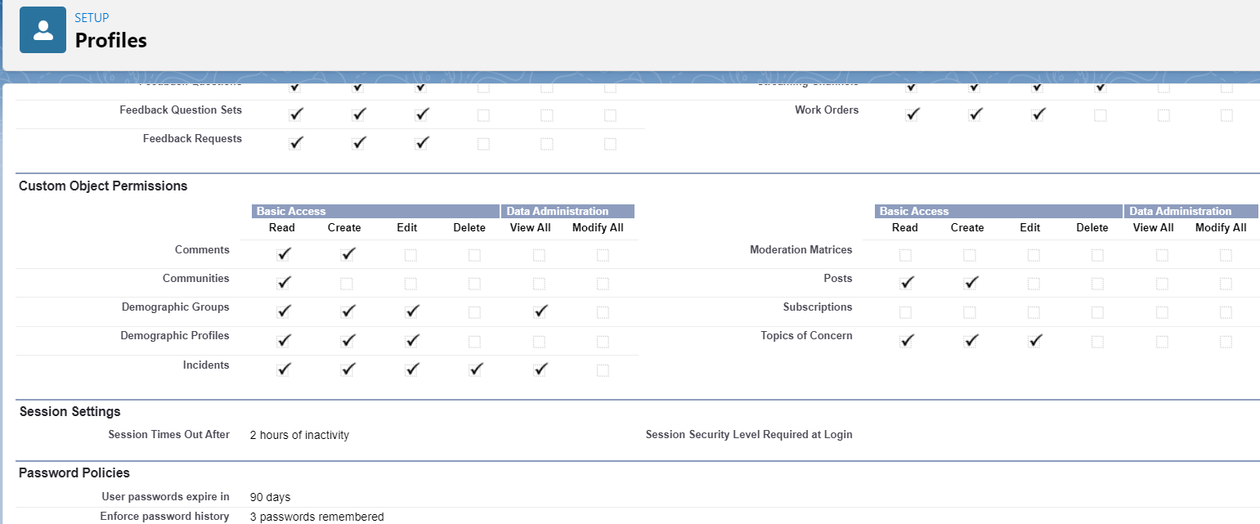

Slide 11
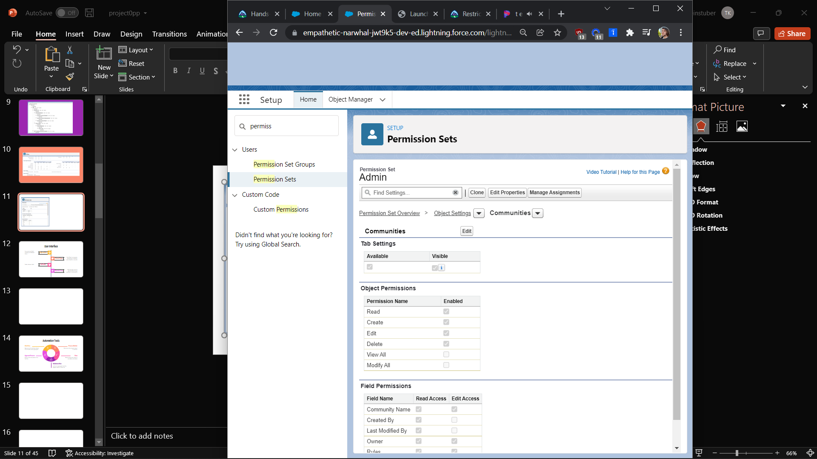
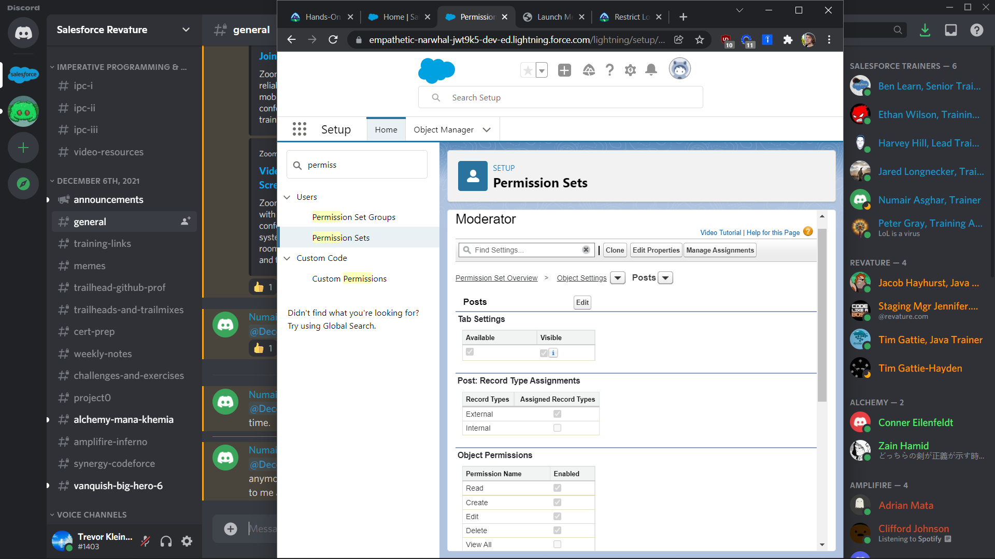

Slide 12
User Interface
Can cutomize Field visibility and Related items
Page Layout
Record Type
One Object can appear differently to different users based on records
Table, Kanban, Split
List View
Dynamic Form
Lightning App Lets Us dynamically change visibility of components

Slide 13
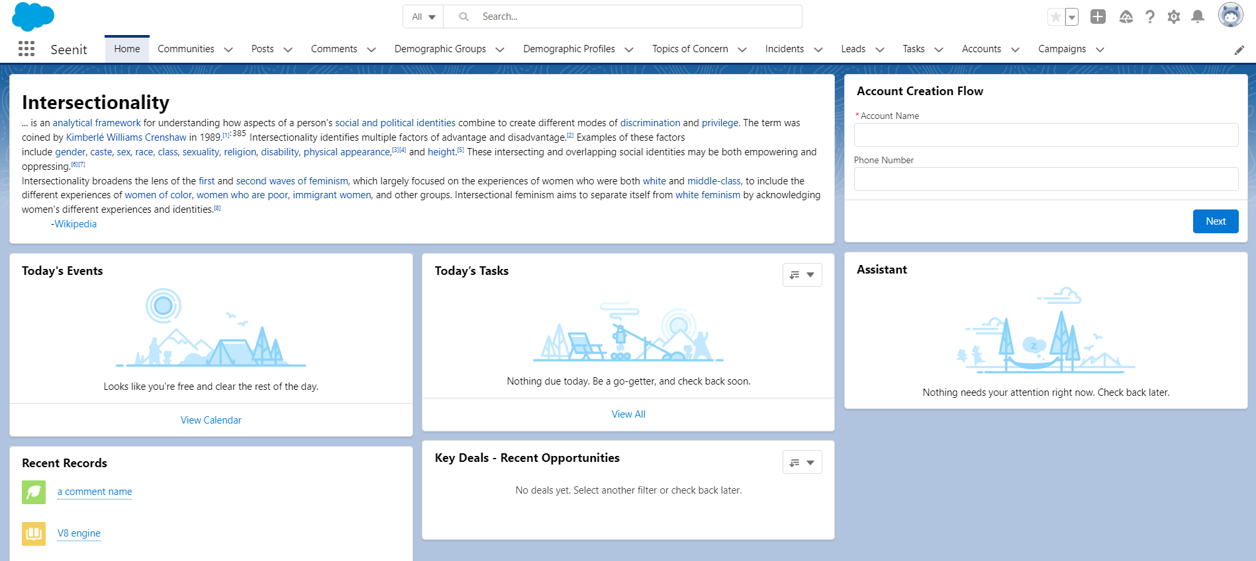
Demo app …

Slide 14
Automation Tools
Workflow Rule
Process Builder
Neptune is the farthest planet from the Sun and a gas giant
Mercury is the closest planet to the Sun
Approval Process
Flow
Earth is the third planet from the Sun
Despite being red, Mars is actually a cold place
Validation Rule
Jupiter is a gas giant and the biggest planet of them all

Slide 15
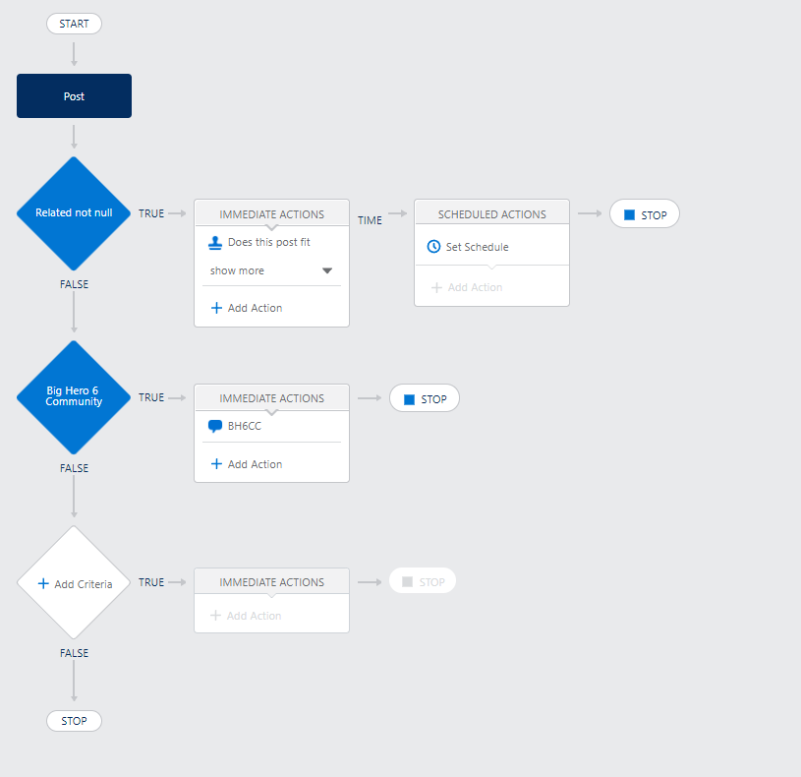

Slide 16
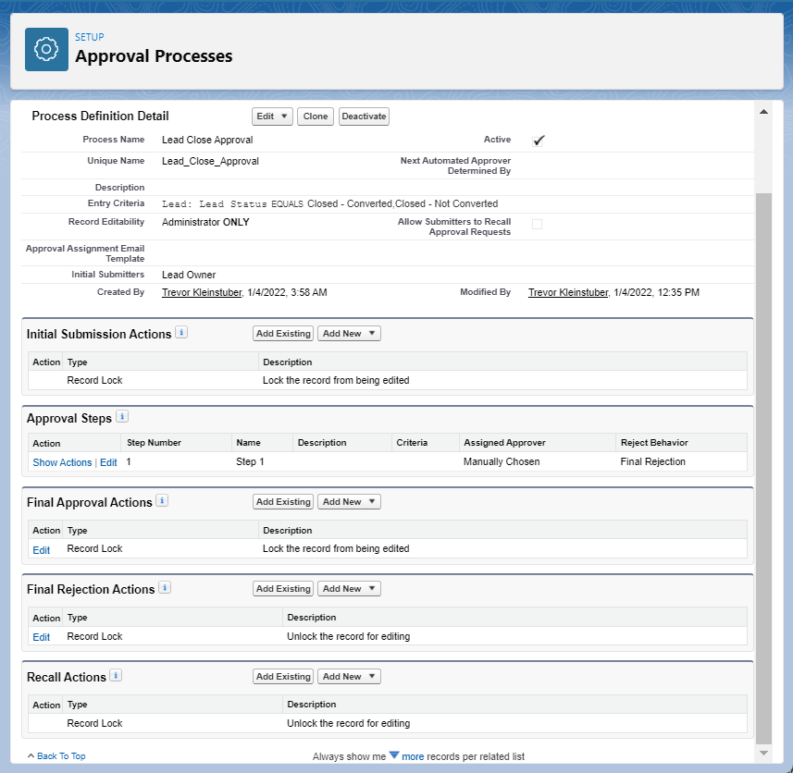

Slide 17
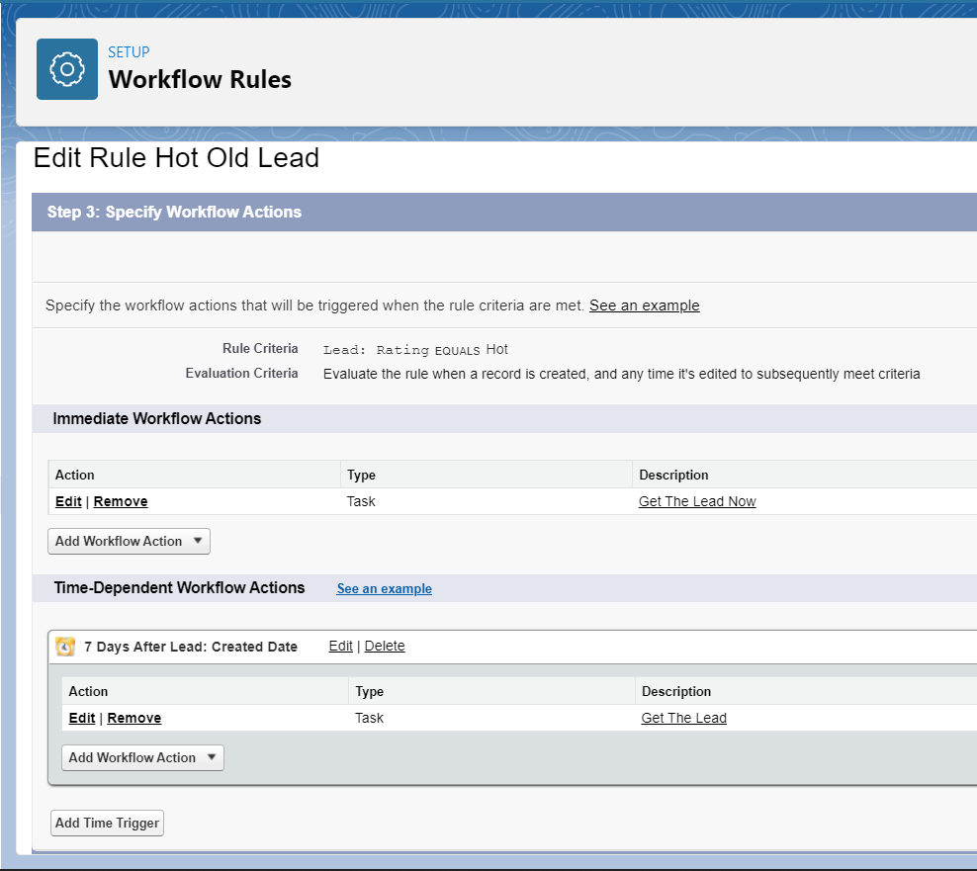
Demo Flow, Validate Profile

Slide 18
Service Cloud & Sales Cloud
Assignment Rules
Auto-Response Rules
Saturn is composed of hydrogen and helium
Case
Mercury is the smallest planet in the Solar System
Team
Lead
Escalation Rules
Campaigns, Products & Price books
Jupiter is a gas giant and the biggest planet
Opportunity
Neptune is the farthest planet from the Sun

Slide 19
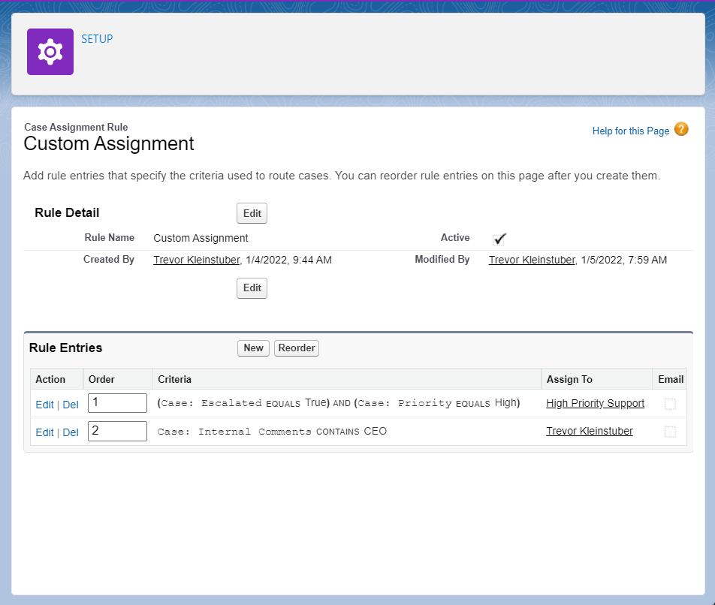

Slide 20
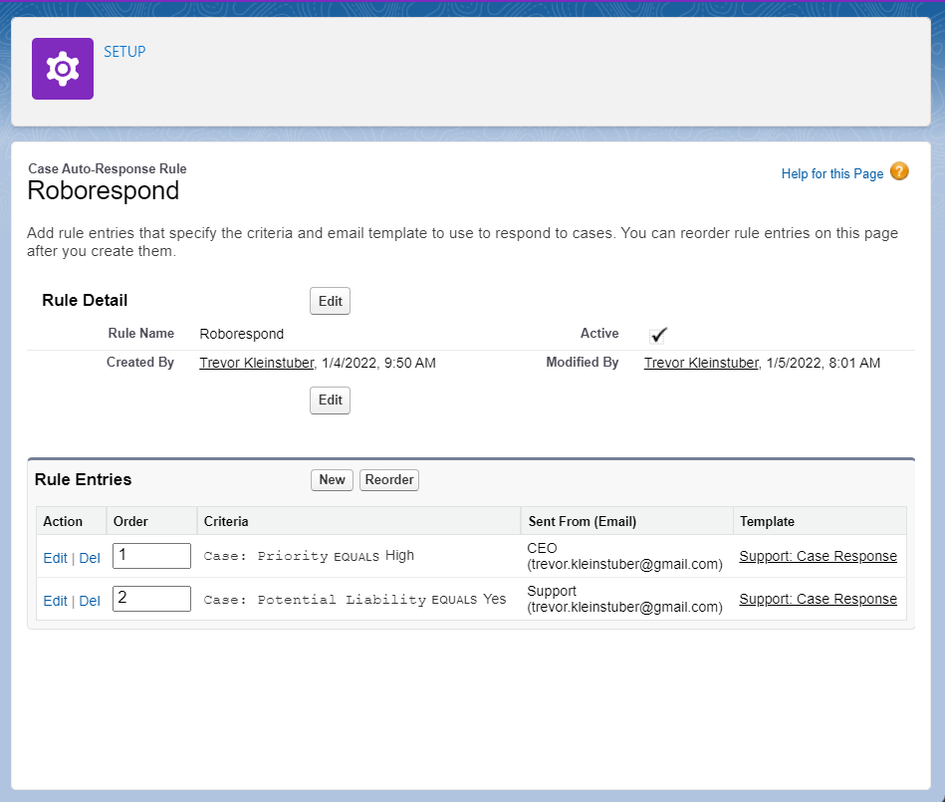

Slide 21
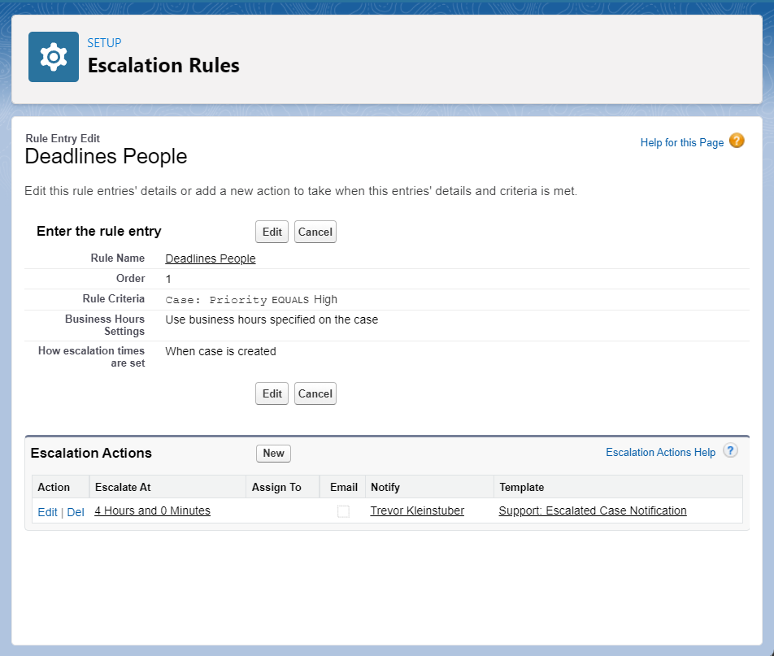

Slide 22
Let’s Look at Webpage Schema Builder List Views Validation and Flow in Action
Slide Templates created by Slidesgo and Freepik

